Slide 1
Customer Churn Analysis Protecting Our Revenue, One Customer at a Time
Presented by: Ali Mohamed
Data Scientist
May 2026

Slide 2
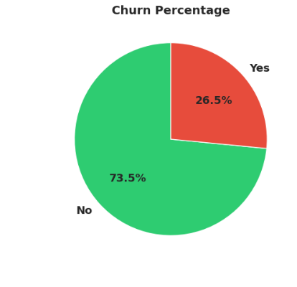
We're Losing 1 in 4 Customers
🚨 We're Losing 1 in 4 Customers
📉 Current State:
26.5% customer churn rate
1,869 customers lost out of 7,043
💸 Estimated Revenue Impact:
• $1.87M annual revenue at risk
• Based on $1,000 average customer value
❓ The Critical Question: "Can we predict WHO will leave BEFORE they do?"

Slide 3
📋 Three Key Takeaways
1️⃣ WE BUILT A PREDICTION SYSTEM
84% accuracy in predicting churn
Catches 8 out of 10 at-risk customers
2️⃣ WE IDENTIFIED THE ROOT CAUSES
3 high-risk customer segments
1 service driving 42% of churn
3️⃣ WE HAVE A CLEAR ACTION PLAN
Potential $185K+ annual savings
Ready to deploy in 2 weeks

Slide 4
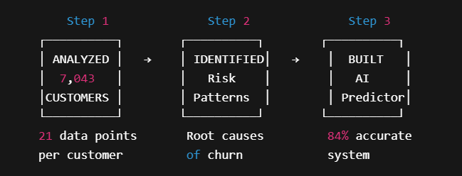
🔍 How We Approached This

Slide 5

👥 The 3 Highest-Risk Customer Segments
🔴 SEGMENT 1: New Customers (First Year)
• Churn Rate: 47%
• Why: Haven't built loyalty yet
• Recommended Action: Onboarding program
🔴 SEGMENT 2: Month-to-Month Contracts
• Churn Rate: 43%
• Why: No commitment, easy to leave
• Recommended Action: Push annual contracts
🔴 SEGMENT 3: Fiber Optic Users
• Churn Rate: 42%
• Why: Possible service quality issues
• Recommended Action: Immediate investigation

Slide 6
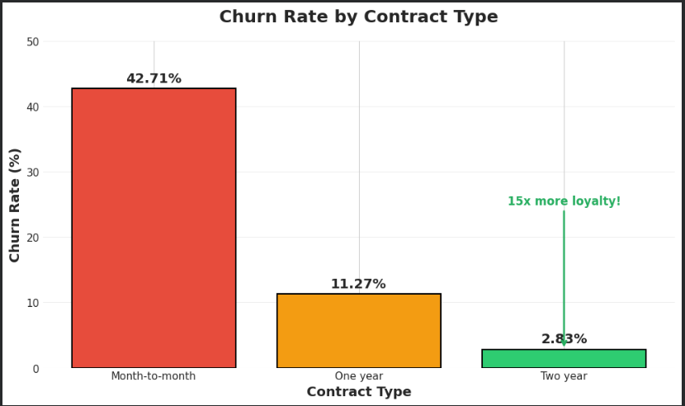
💡 The #1 Insight That Changes Everything
Contract Length Is The MOST POWERFUL Retention Tool We Have
📊 Churn Rate by Contract Type:
Month-to-Month: 42.71%
One Year: 11.27%
Two Year: 2.83% 💡
Two-year customers are 15x MORE LOYAL than month-to-month customers

Slide 7
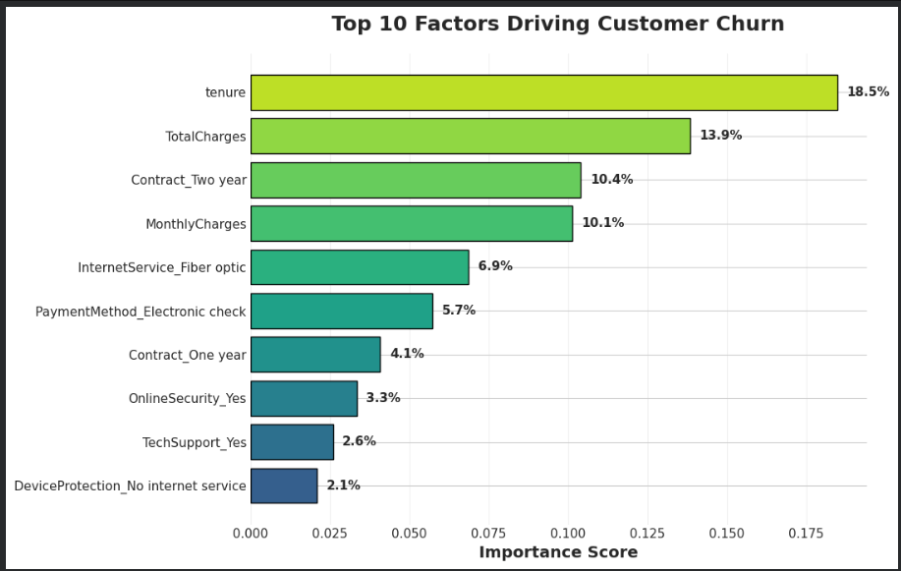
🤖 Meet Our Early Warning System
What it does:
✅ Scans every customer profile daily
✅ Calculates a risk score (0-100%)
✅ Flags high-risk customers
✅ Recommends retention actions
Accuracy Metrics:
🎯 84% overall accuracy
🎯 Catches 8 out of 10 churners
🎯 Tested on 1,409 real cases
Example:
Customer #4521: 🔴 HIGH RISK (87%)
→ Reason: New + Fiber + Monthly contract
→ Suggested action: Offer 1-year discount

Slide 8
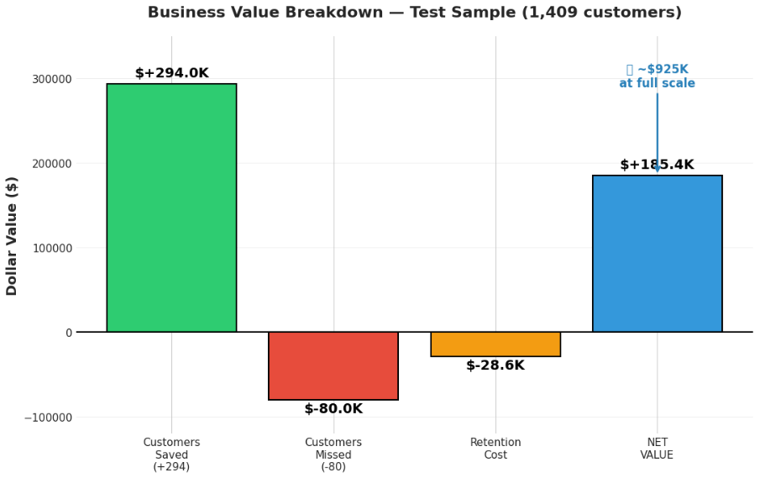
💰 The Bottom Line: $185K+ Annual Savings
On our test sample of 1,409 customers:
Customers SAVED
(caught before they left) 294
Value protected: +$294,000
────────────────────────────
Customers MISSED
(slipped through) 80
Value lost: -$80,000
────────────────────────────
Cost of retention offers -$28,600
────────────────────────────
📈 NET BUSINESS VALUE $185,400

Slide 9
🎯 Our 3-Phase Action Plan
PHASE 1: Quick Wins (Weeks 1-2) ━━━━━━━━━━━━━━━━━━━✅ Deploy AI system to production
✅ Train customer service team on risk scores
✅ Launch "Save Campaign" for top-100 at-risk
1
PHASE 2: Strategic Initiatives (Weeks 3-8) ━━━━━━━━━━━━━━━━━━━🎯 Incentive program: Push annual contracts 🎯 Investigate Fiber Optic service quality
🎯 New customer onboarding program
2
PHASE 3: Continuous Improvement (Ongoing) ━━━━━━━━━━━━━━━━━━━📊 Monthly performance reviews
📊 Quarterly model updates
📊 A/B test retention offers
3

Slide 10

🚀 What We Need From You
✅ APPROVAL TO PROCEED Green light to deploy the system
👥 RESOURCES NEEDED
• 1 developer (2 weeks integration)
• Marketing team alignment
• $50K budget for retention offers (Phase 1)
📅 KEY MILESTONES
• Week 1: System deployment
• Week 4: First results review
• Week 12: Phase 1 ROI report
💬 LET'S DISCUSS
Questions? Concerns? Ideas?
Thank You!

